Slide 1
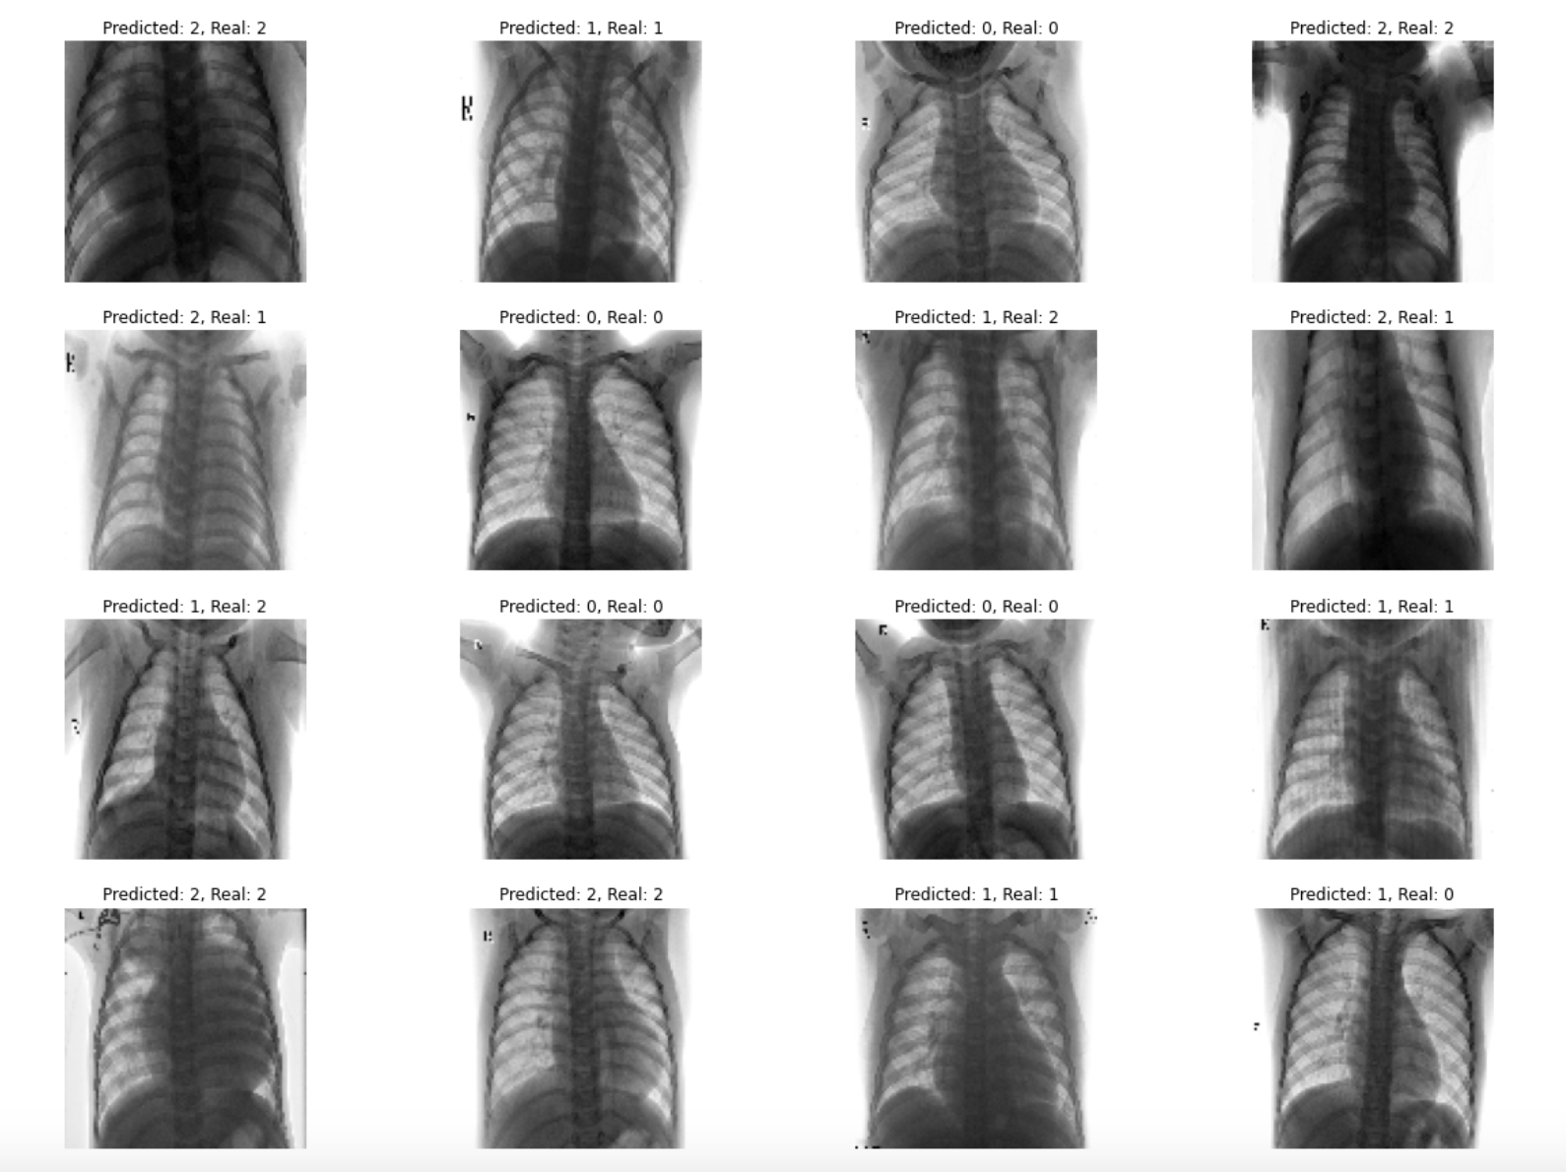
PNEUMONIA X-RAY CLASSIFICATION

Slide 2

NUCLEAR MEDICINE DEPARTMENT DEVELOPMENT

Slide 3
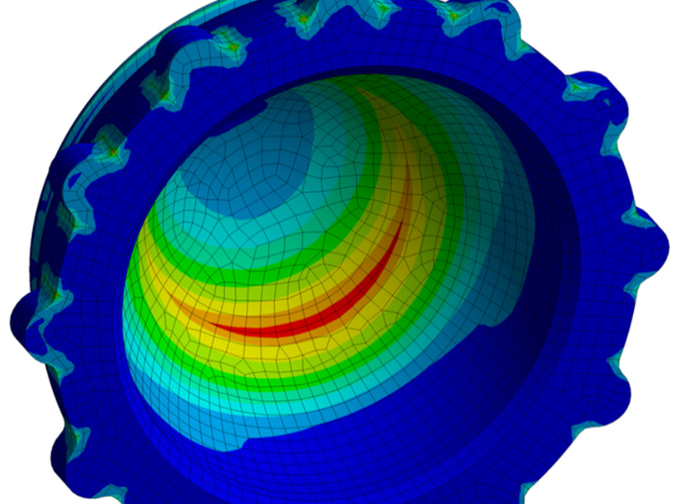
ANALYSIS OF RISK OF WEAR OF HIP IMPLANTS
ARTICLE

Slide 4
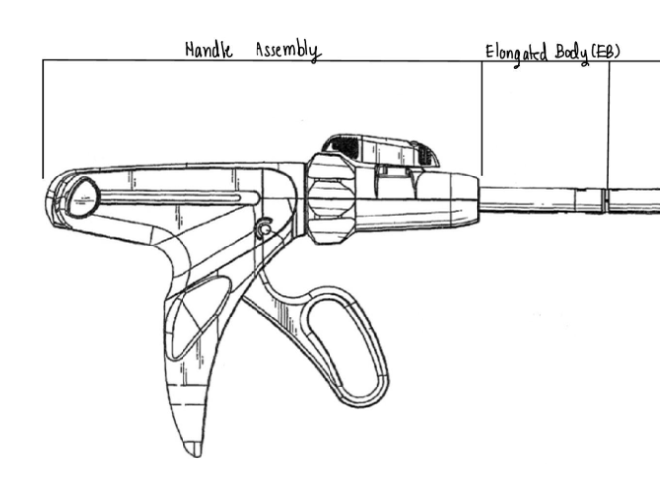
DESIGN OF SURGICAL STAPLER FOR ANATOMOSIS SURGERY

Slide 5
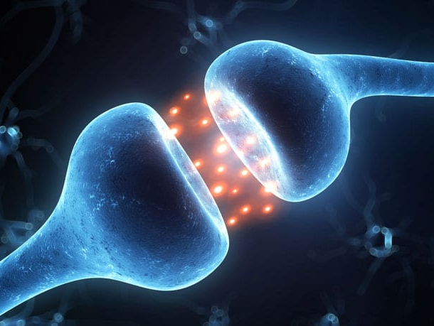
MODELING DOPAMINE CIRCUITRY IN LEARNING AND ADHD

Slide 6
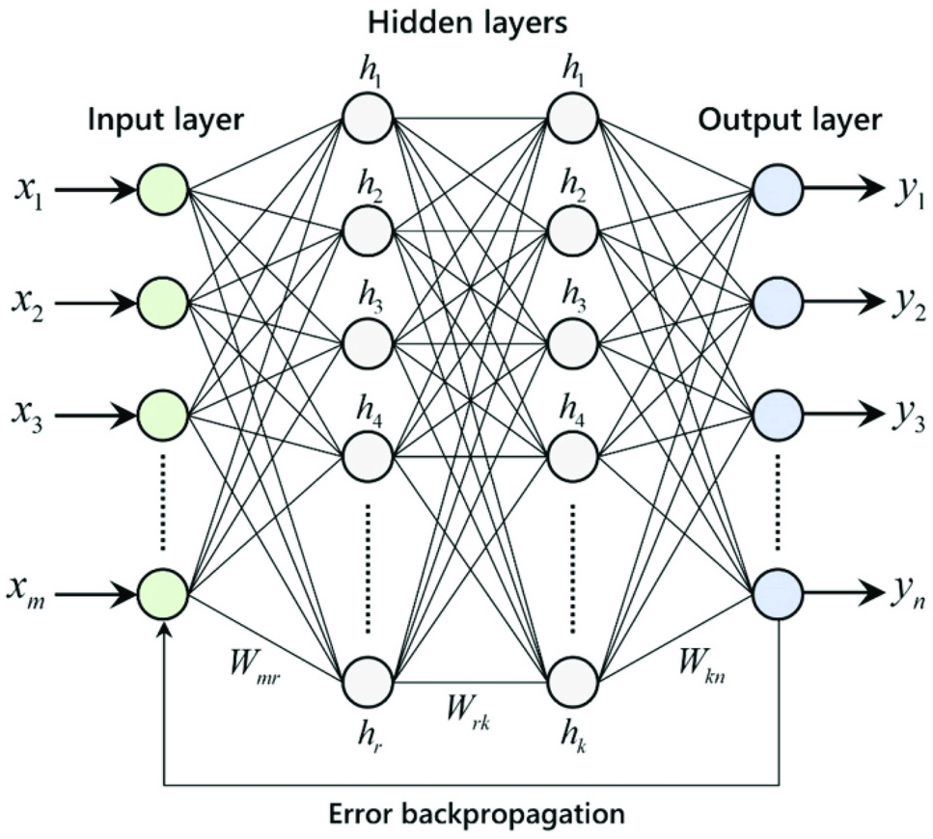
MODEL
FOR PREDICTING INFECTION IN HIP ARTHROPLASTY

